Slide 1
COMPUTER NETWORKS-WEB SOCKETS
Abhishek J M – 4JN18IS001
ISE A Section Jnnce
karunadu4@gmail.com

Slide 2
Table Of Contents
NO | TOPICS
1 | HTTP vs URL
2 | An Introduction to HTTP
3 | How does HTTP Protocol Works?
4 | What are Web Sockets?
5 | Additional Overview
6 | Implementation
7 | Protocol Handshake
8 | Security Considerations
9 | Proxy Handshake
10 | Pros & Cons
11 | Why should we not use Web Sockets?
12 | Do we have to use Web Sockets?

Slide 3
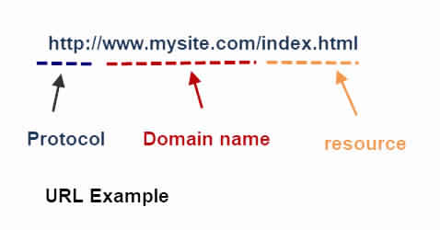
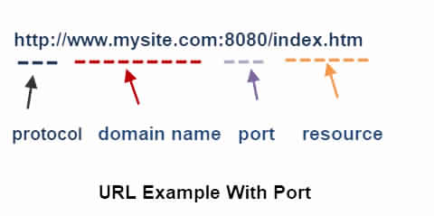
HTTP vs URL
This tells the web browser the address of the resource to locate and the protocol to use to retrieve that resource (http).

Slide 4
An Introduction to HTTP
HTTP stands for hypertext transfer protocol and is used to transfer data across the Web.
All requests originate at the client ( your browser)
The server responds to a request.
The requests(commands) and responses are in readable text.
The requests are independent of each other and the server doesn’t need to track the requests.

Slide 5
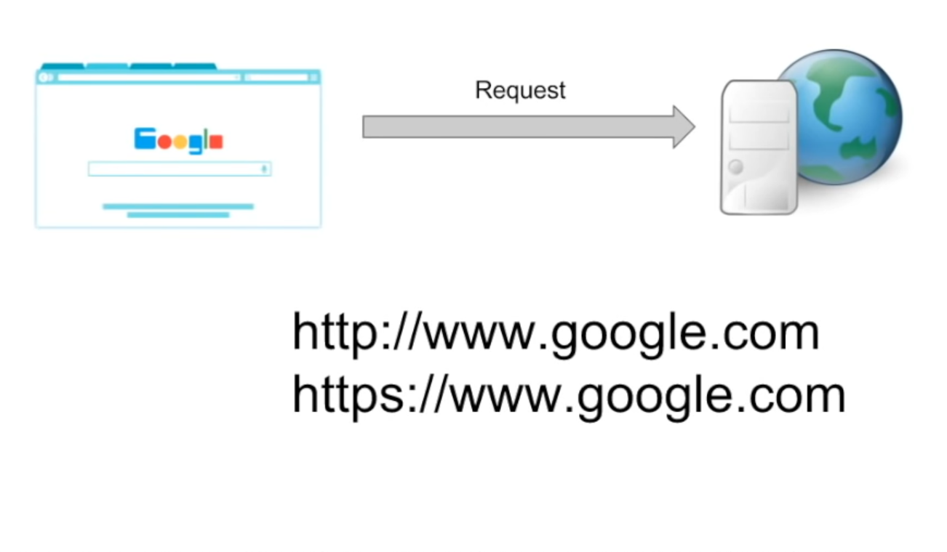
HOW DOES HTTP PROTOCOL WORKS?
Considering a typical google.com. When we hit a google.com, request goes to backend servers. The request goes in the form of http or https. Which they are the communication protocols that the browser uses to interact with the server.
TCP Connection will setup between Client & Server. And the number of requests = number of TCP connections.
After a Particular request the server responds to the request. After the response the connection gets disconnected. We have to refresh the UI to setup new connection. Which can be defined in one word as it is Stateless.
Hence the communication mode is unidirectional.

Slide 6
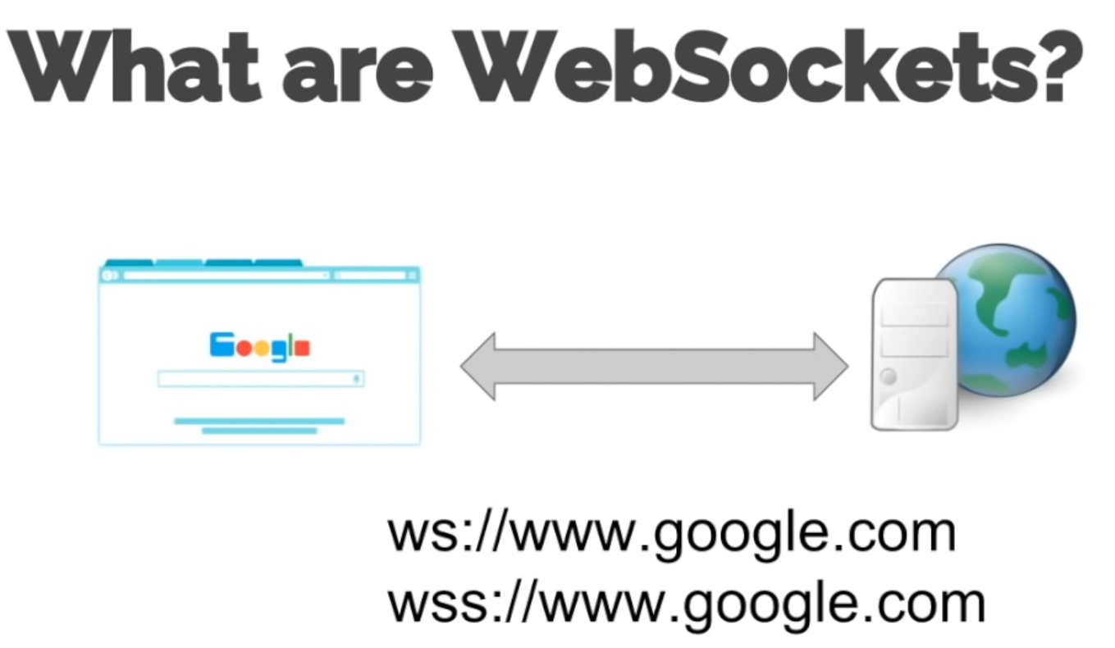

Slide 7
EXPLAINATION
Vice Versa of HTTP & HTTPS mode of communication.
Bi-Directional between web sockets.
Both Client & Servers will interact coherently.
Example : Chatting Application. Once the connection get’s setup, there will be Bi-Directional communication between the client & the server till both decides to terminate the connection.
One TCP connection is enough to setup the connection.
Which can be defined in one word as it is State full.

Slide 8
Additional Overview
The Web Socket protocol specification defines ws (Web Socket) and wss (Web Socket Secure) as two new uniform resource identifier (URI) schemes that are used for unencrypted and encrypted connections, respectively.
Using browser developer tools, developers can inspect the Web Socket handshake as well as the Web Socket frames.

Slide 9
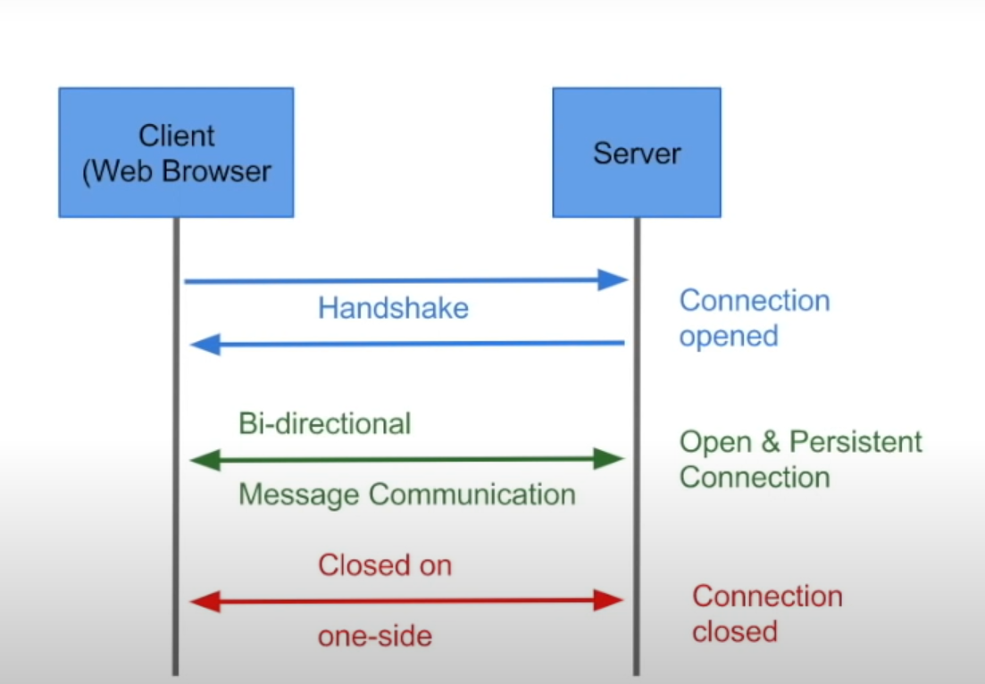

Slide 10
IMPLEMENTATION
Gaming Applications.
Chat Applications.
Live Feed.
Showing Client progress/logging [Upload]
Real Time Applications. If Real time updates are not needed, then Web Sockets are no of use.

Slide 11
Protocol Handshake
To establish a WebSocket connection, the client sends a WebSocket handshake request, for which the server returns a WebSocket handshake response, as shown in the example below:
Client request:
GET /chat HTTP/1.1 Host: server.example.com Upgrade: websocket Connection: Upgrade Sec-WebSocket-Key: x3JJHMbDL1EzLkh9GBhXDw== Sec-WebSocket-Protocol: chat, superchat Sec-WebSocket-Version: 13 Origin: http://example.com
Server response:
HTTP/1.1 101 Switching Protocols Upgrade: websocket Connection: Upgrade Sec-WebSocket-Accept: HSmrc0sMlYUkAGmm5OPpG2HaGWk= Sec-WebSocket-Protocol: chat

Slide 12
Security Considerations
Unlike regular cross-domain HTTP requests, Web Socket requests are not restricted by the Same-origin policy. Therefore Web Socket servers must validate the "Origin" header against the expected origins during connection establishment.
To avoid Cross-Site Web Socket Hijacking attacks (similar to Cross-site request forgery), which might be possible when the connection is authenticated with Cookies or HTTP authentication. It is better to use tokens or similar protection mechanisms to authenticate the Web Socket connection when sensitive (private) data is being transferred over the Web Socket.

Slide 13
Proxy Traversal
If unencrypted Web Socket traffic flows through an explicit or a transparent proxy server without Web Sockets support, the connection will likely fail.
If an encrypted Web Socket connection is used, then the use of Transport Layer Security (TLS) in the Web Socket Secure connection ensures that an HTTP CONNECT command is issued when the browser is configured to use an explicit proxy server. This sets up a tunnel, which provides low-level end-to-end TCP communication through the HTTP proxy, between the WebSocket Secure client and the Web Socket server.

Slide 14
Pros & Cons
Pros
Cons
Full Duplex (no polling) Updates.
HTTP compatible. Because first we send a HTTP request & upgrade it to websocket.
Freindly
Timeouts. We shouldn’t terminate the connection.

Slide 15
What should you not use WebSockets for?
Don’t use a WebSocket for anything other than realtime two-way communication. Here’s why:
HTTP already implements a request/response protocol.
HTTP already has timeouts for requests.
HTTP/2 already uses a single connection for multiple requests. HTTP 1.1 already uses a single connection for multiple sequential requests.
HTTP already has caching built-in. Caching software exists for HTTP (e.g., Varnish).
HTTP already has a way to uniquely identify remote resources (URLs).
HTTP already has means of providing metadata (headers).
HTTP already has a way of maintaining state across requests and browser sessions (cookies).
HTTP has built-in, standardized response codes.
Very good tooling already exists for HTTP.
HTTP is well-supported everywhere. WebSockets can have problems behind firewalls and other kinds of proxies.

Slide 16
Do we have to use Web Sockets?
If we need Bi-Directional Communication.
Event Source is the push notification.
Long Polling – The server can only send the information if its has the information. For that client has to wait & server will not know that client is still in the connection. For that we use the concept called long polling.

Slide 17

THANK YOU!

